Slide 1



SmartSpend
An AI-Assisted Mobile Financial Tracking and Advisory Application for Personal Financial Management
Directo, Brix A.
Rubis, Cyrille John M.
Madayag, Djaunathan Albert S.
Adviser: Ellen Flores Mangaoang, DIT
College of Computer Studies and Engineering, LORMA Colleges
November 16, 2026 | 3:00 PM
Panel: Jeoffrey B. Layco MIS (Chair) | Shekiro R. Raposas MTS/MIS | Mary-Ann Mzana MTS

Slide 2

Opening Prayer

Slide 3

Money is managed without a system
2%
< 50%
10%
of Filipino adults answered all six basic financial literacy questions correctly
reported keeping any household or personal budget
of our 30 respondents used a mobile app to track expenses
BSP Financial Inclusion Survey, 2021
BSP Financial Inclusion Survey, 2021
SmartSpend needs assessment
A mixed picture (BSP CFIS 2025): basic literacy rose from 69% to 74%, but formal account ownership fell from 56% to 50%.
SmartSpend | LORMA Colleges, CCSE

Slide 4



The gap exists at three levels
International
National (PH)
Demographic
PROBLEM
PROBLEM
PROBLEM
Manual entry dominates; AI categorization degrades for non-English transactions.
Local apps lack LLM chat, spending behavior analysis, and health scoring.
Parents abandon apps due to manual effort; warnings are ignored without consequences.
SMARTSPEND
SMARTSPEND
SMARTSPEND
LLM-based parsing for Filipino-English input
Conversational AI, Financial Health Score, multi-period summaries
Automated input and a score decay consequence system
SmartSpend | LORMA Colleges, CCSE

Slide 5
What existing apps leave out
Feature | Tarsi | YNAB | Monarch | Copilot | BudgetPH | Alkansya AI | SmartSpend
Offline mode | ✓ | – | – | – | ✓ | – | ✓
LLM chat assistant | – | – | – | – | Insights | Basic | ✓
Financial Health Score | – | – | – | – | Simpler | – | ✓
OCR receipt scanning | ✓ | – | – | – | – | – | ✓
Voice input (en-PH) | – | – | – | – | – | – | ✓
Filipino-English AI | – | – | – | – | – | ✓ | ✓
Batch screenshot import | – | – | – | – | – | – | ✓
Bank synchronization | – | ✓ | ✓ | ✓ | CSV | – | –
Hands-on comparison of the apps in Table 2. Other PH apps (Agila, PISO Budget Tracker, Lista, Kibo, BunnyWise, GCash Pera Coach) are acknowledged; SmartSpend is an evaluated integrated prototype, not a claim to be first or only.
SmartSpend | LORMA Colleges, CCSE

Slide 6
Three objectives guided the study
1
Assess
Financial management practices, budgeting challenges, and expense tracking behaviors of parents (35–55) and young professionals (21–35) in San Fernando City, La Union.
2
Design and develop
The SmartSpend app: multi-modal input, cloud sync, and an LLM API selected through comparative technical evaluation.
3
Evaluate
Usability of the developed system using the System Usability Scale (SUS).
SmartSpend | LORMA Colleges, CCSE

Slide 7
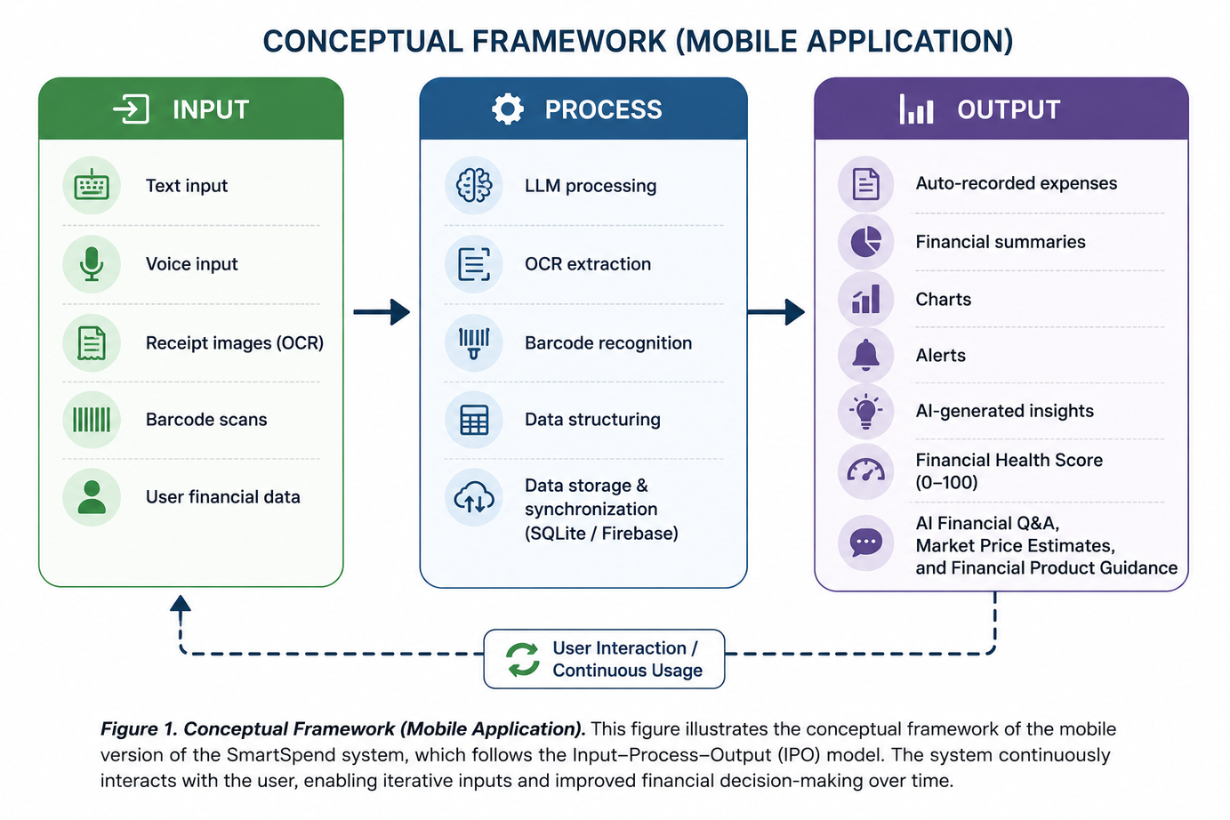
The Input-Process-Output framework
Input
Text, voice, receipt images, barcodes, user financial data
Process
LLM parsing, OCR, barcode recognition, SQLite storage, Firebase sync
Output
Auto-recorded expenses, charts, alerts, insights, Financial Health Score, AI Q&A
SmartSpend | LORMA Colleges, CCSE

Slide 8
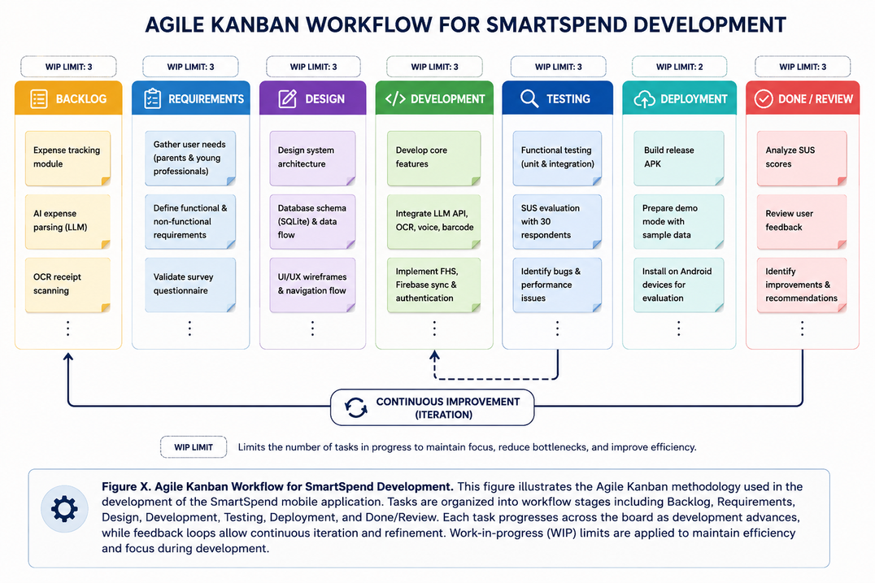
Quantitative descriptive developmental, built with Agile Kanban
30
respondents (needs assessment), random sampling: 16 parents + 14 young professionals = 30
2
Separate SUS sample: 30 valid of 36 (10 parents, 20 young professionals)
10
item SUS questionnaire; self-directed use for 10+ minutes (screening confirmed)
SmartSpend | LORMA Colleges, CCSE
Notes:
Note: Purposive sampling was used for the content validator (Avigail Candevario, PFMe) — selected based on her expertise in personal financial management. Random sampling was used for all 30 respondents.

Slide 9
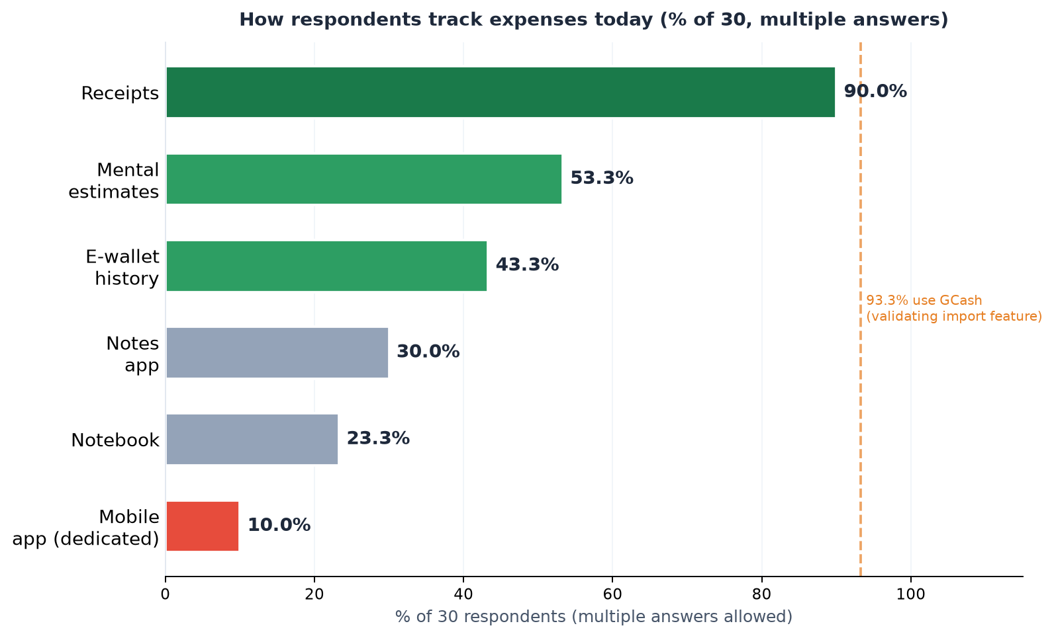
Objective 1: the need is real
96.7%
How respondents track expenses today (% of 30, multiple answers)
(29 of 30) intend to use an AI-powered financial app
93.3%
already used GCash (28 of 30)
SmartSpend | LORMA Colleges, CCSE
Notes:
Key tracking method findings (from Table 5):
• 90% used physical receipts — validates OCR scanning as core feature
• 53.3% used mental estimates — validates natural language AI logging
• 43.3% used e-wallet transaction history — validates GCash import
• Only 10% already used a dedicated budgeting app — confirms the gap
• 93.3% use GCash — confirms e-wallet parsing as priority feature

Slide 10
SmartSpend v3.1.0 at a glance
34
7
40+
26
autonomous AI actions
input modalities
screenshot platforms
SQLite tables
45
36
9
57
screens
achievement badges
AI providers (8 cloud + local)
currencies
Flutter (Android) • SQLite offline-first • Firebase sync and auth • APK ≈ 47.5 MB
SmartSpend | LORMA Colleges, CCSE

Slide 11
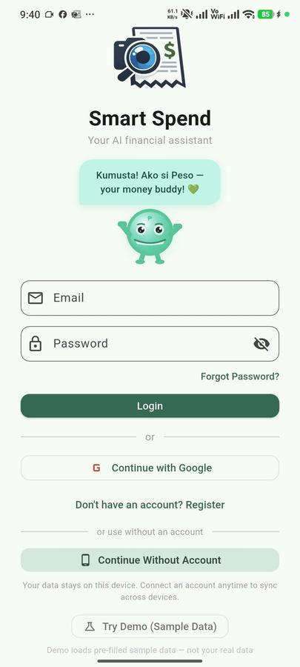
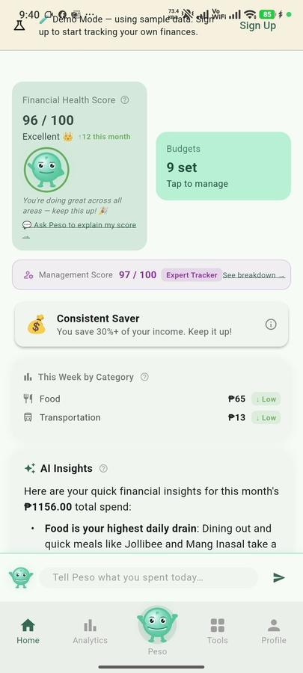


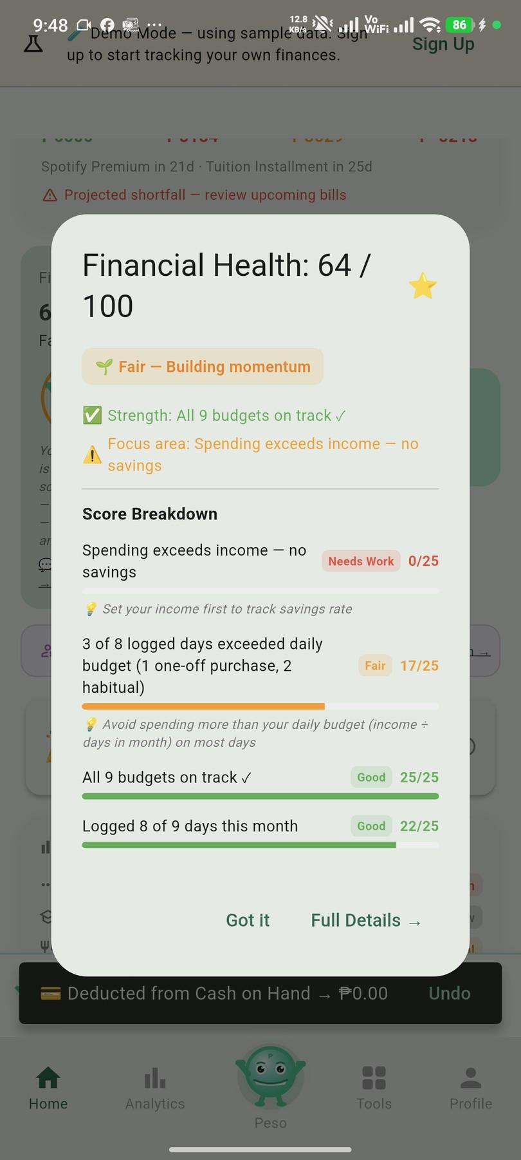
The app in action
Figure 9. Login and Demo Mode
Figure 10. Home Dashboard
Figure 11. Expense Logging Through Peso Chat
Figure 12. Receipt Scanning and Batch Screenshot Import
Figure 13. Financial Health Score Breakdown
SmartSpend | LORMA Colleges, CCSE

Slide 12
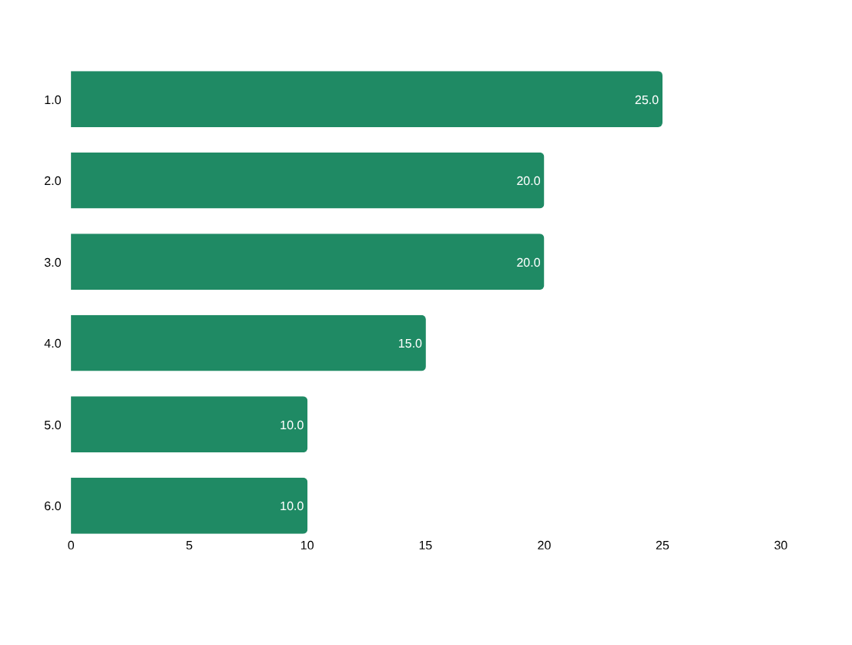
Choosing the AI engine
Evaluation: 6 weighted criteria, 10 candidate models from 4 providers
PRIMARY MODEL
Gemini 3.5 Flash-Lite
1M-token context, native function calling for 34 actions, strong Taglish in trials, high free-tier quota
7 fallback providers across Google, Groq, and Cerebras keep the assistant running if one is down or rate-limited.
Full-context injection, not RAG: a user's data is only ~1,000–5,000 tokens.
SmartSpend | LORMA Colleges, CCSE

Slide 13
Financial Health Score: 0 to 100
Full Mode (income tracking on)
25
pts
25
pts
25
pts
25
pts
Savings Rate
Overspend Control
Budget Adherence
Logging Consistency
Lightweight Mode (no income tracking)
25
pts
25
pts
25
pts
25
pts
Spending Restraint
Logging Consistency
Category Balance
Habit Streak
Warning Decay up to −15 Gap Adjustment +2 no-spend / −3 unlogged day Clamped 0–100
SmartSpend | LORMA Colleges, CCSE
Notes:
FHS Score Adjustments (for panelist questions):
• Warning Decay: up to −15 pts for discretionary overspend (loss aversion principle)
• Gap Adjustment: +2/day confirmed no-spend, −3/day unlogged-but-presumed-spent
• Final score clamped 0–100
• Lightweight Mode for users without fixed income: Spending Restraint + Logging Consistency + Category Balance + Habit Streak

Slide 14
Privacy by design: three AI tiers
1
Cloud AI (default)
2
Private Local Mode
3
On-device AI
On-device redaction of mobile numbers, reference numbers, and account patterns. 150 AI requests per user per day. Disclosure shown before the first AI message.
Requests go only to a model on the user's own PC (Ollama, LM Studio, Jan). Local-only switch blocks cloud fallback.
A model running on the phone itself, with no network required. NOT yet built — presented as Recommendation 4. Most target-user devices lack the RAM to run a 2.6 GB model.
Implemented
Implemented
Planned
Designed with the Data Privacy Act of 2012 in mind. A risk-reduction measure, not a certification of legal compliance.
SmartSpend | LORMA Colleges, CCSE

Slide 15
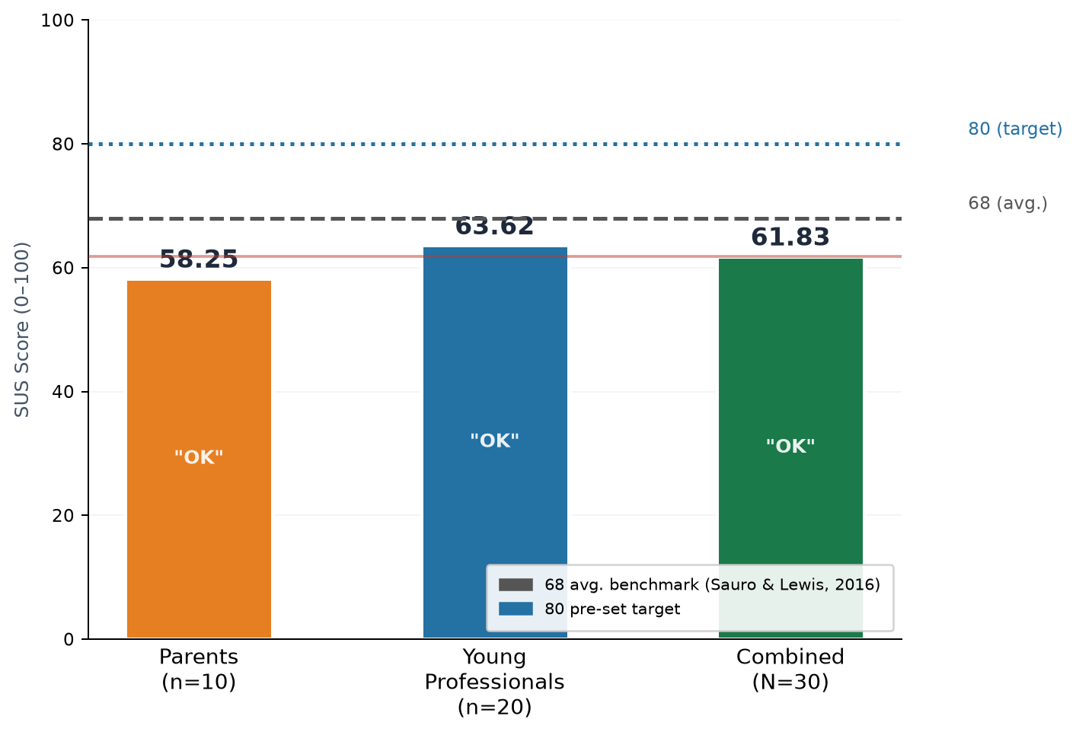
Objective 3: usability scored 61.83 (OK)
61.83
Mean SUS score (N = 30 valid of 36 responses)
Grade D, adjective "OK"
SD 17.58, median 55.0
Range 35.0–92.5
Below 68 avg. benchmark (Sauro & Lewis) and 80 target
Q1 intent to use often: 4.35 / 5
Q9 felt confident: 4.19 / 5
Concerns: consistency (Q6), complexity (Q2, Q4)
SmartSpend | LORMA Colleges, CCSE
Notes:
Group breakdown (from Table 8):
• Parents (35–55), n=10: Mean=58.25, SD=19.72, Range=35.0–90.0 — adjective: OK
• Young Professionals (21–35), n=20: Mean=63.62, SD=16.65, Range=42.5–92.5 — adjective: OK
• YP scored slightly higher, consistent with higher mobile familiarity
• Both groups fell below the 68 benchmark and 80 target

Slide 16





Limitations we acknowledge
Usability below target
Android and internet
Prototype-grade security
SUS 61.83 is under the 68 avg. benchmark (Sauro & Lewis 2016) and the 80 target.
Android only; all AI features need a connection.
API key via Remote Config; local database not encrypted.
Parsing accuracy
Behavior impact unmeasured
Small, local sample
91.2% precision / 88.5% recall from developer testing.
Peso and badges were added after the evaluation was designed.
30 SUS respondents from one locale; not generalizable.
SmartSpend | LORMA Colleges, CCSE

Slide 17
Conclusions
1
Needs assessment
96.7% intent to use an AI finance app; 93.3% used GCash.
Achieved
2
Design and development
v3.1.0 working Android app: 34 AI actions, Gemini 3.5 Flash-Lite (selected from 10 candidate models) with failover, Financial Health Score.
Achieved
3
Usability evaluation
SUS 61.83: below the 68 average and the 80 target; UI/UX areas identified
Partially achieved
SmartSpend | LORMA Colleges, CCSE

Slide 18
Recommendations
Payday-cycle budgeting
Resets aligned to the 15th and 30th salary cycle
SQLite encryption
SQLCipher for the local database
1
5
Backend API proxy
Server-side keys and per-user limits; remove device-side key exposure
Household and remittance
Shared wallets and OFW remittance as a distinct income category
2
6
Google Play release
After backend proxy and privacy policy are in place
Longitudinal evaluation
3–6 months, larger sample, measure behavior change
3
7
3–6 months, larger sample, measure behavior change
7
On-device AI tier
Opt-in ~2.6 GB model for fully offline AI
4
SmartSpend | LORMA Colleges, CCSE
Notes:
Recommendations 8 and 9 (say these after presenting 1–7):
8. UI/UX refinement — Address consistency (Q6) and complexity (Q2) from SUS
9. Formal parsing evaluation — 50+ standardized receipts for OCR/AI accuracy measurement

Slide 19

Salamat po!
Questions and discussion
Directo, Rubis, Madayag
Adviser: Ellen Flores Mangaoang, DIT
github.com/Zushikina-kun/smartspend-app

